Slide 1
The NLP Silver Bullet for Search
Eric Brill
Text Mining, Search and Navigation Group
Microsoft Research

Slide 2

arm hurts
SEARCH
  Ggrrrr!!: My arm hurts!!
  Ggrrrr!! June 09, 2003. My arm hurts!! On Saturday, I was helping my mom with the yard work and I think I did something to my arm. I was using the week wacker to trim the edges and when I woke up the next morning my arm hurt.
  em-qu.com/mt-arch/000093.html
  my arm hurts
  stay on the scene. get on up. i. you could email me
  alkalinepixi.diaryland.com/1174.html
  Daisy Blossom: My arm hurts
  August 12, 2003. My arm hurts. I hurt my arm but I dont know how. I think I strained a muscle or something. OW! Posted by Tiff at August 12, 2003 09:42 PM | Trackback. Comments. Tiff was trying to catch fish in the pond again...
  www.daisyblossom.com/archives/000354.html

Slide 3
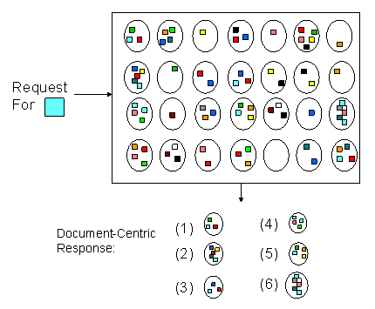
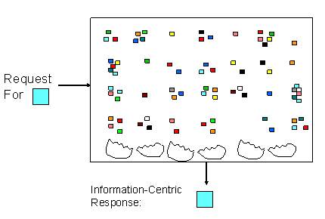
Information-Centric Search

Slide 4
Information-Centric Search
Where we are:
  ~75% accuracy on open “factoid” questions
    What museum is the Mona Lisa in?
  ~2x efficiency improvement on non-factoid questions, compared to search engine.
    Why does plasma TV manufacturing have such a high defect rate?
Where we will be:
  Information synthesis
    Is George Bush Jr. an effective president?
    How much aspirin should I take for my heart?

Slide 5
Dialog-Driven Search
<10 sec
Type Query
Return Results
<100msec
Explore Results
Tom: I’m planning a fly fishing trip to Idaho.
Joe: Where in Idaho?
Tom: I don’t know. I’m actually new to fly fishing. I just
got a really big bonus at work and thought I’d treat
myself.
Joe: So a fancy hotel, fancy restaurant, the works?
Tom: Nah, I’m not into that. Just someplace isolated
and beautiful. With great fishing, of course.
Joe: What time of year?
Tom: I’m flexible. I’d like to go for a week.
Joe: Would you prefer to spend the entire time on
one river? And I assume you’ll want a fishing guide?

Slide 6
Challenges
Business model to support ⁭ ⁭ CPU cycles per query?
How far can we go without solving AI?
  Menus/forms/federating
  Tons of data!!

